Slide 1
SMS Spam Classification
Using spam.csv dataset from kaggle
Members of the Team
Kunal Mallick(24167002)
Akankhya Abhisikta Lenka(24167008)
Soham Adhikari(24167029)
Anushka Khatua(24167030)

Slide 2
Introduction
What is Spam Classification ?
The process of identifying and filtering unwanted or harmful messages.
Common applications: Email filtering, SMS spam detection, and chat moderation.
Why LSTM ?
LSTM (Long Short-Term Memory) is ideal for text data as it captures sequential patterns and long-term dependencies

Slide 3
Overview of the project
Objective:
Build an accurate and scalable model to classify messages as spam or not spam.
Challenges:
Handling noisy and unstructured text data.
Addressing class imbalance in datasets.
Minimizing false positives and false negatives.

Slide 4
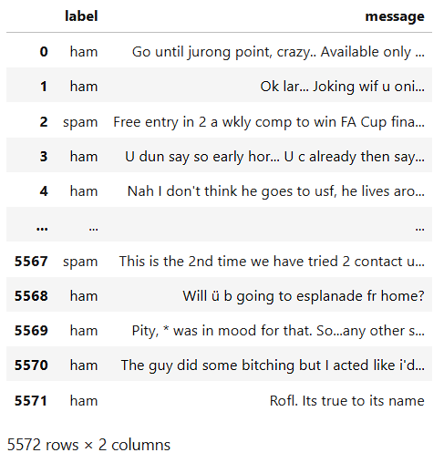
Dataset Overview
Source:
Kaggle - spam.csv
Size:
5,572 rows, 2 columns
Columns:
label (ham or spam)
message (sms content)

Slide 5
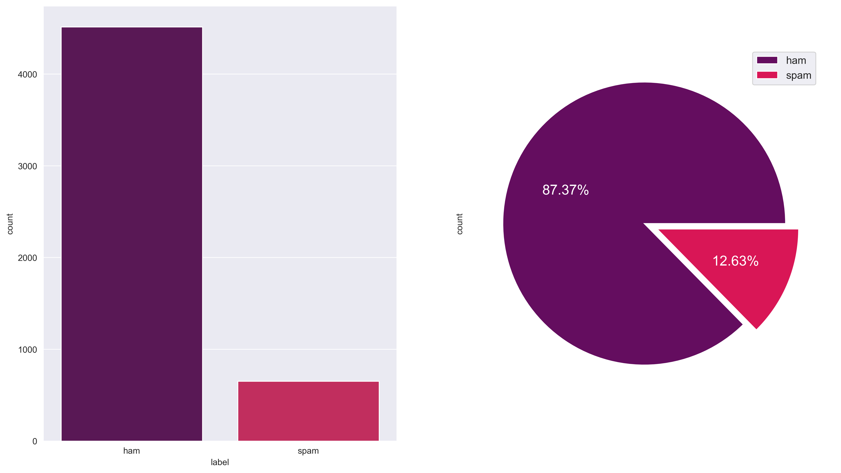
Label
Type : object
Unique : 5,169
Missing : 0(0.0%)
Spam : 13.4% (747)
Ham : 86.6% (4,825 )

Slide 6

Message
Top Words
Spam: "win", "free", "call"
Ham: "ok", "good", "know"

Slide 7
Proposed Model Details
Model Used : Long Short-Term Memory (LSTM)
Model Description :
LSTM is a type of recurrent neural network (RNN) that can learn and predict sequential data. LSTMs are designed to process and retain information over multiple time steps, and are effective at capturing long-term dependencies.
LSTMs use specialized "gates" to manage short-term and long-term memory, which helps prevent issues like gradient vanishing or exploding that can occur in standard RNNs.

Slide 8
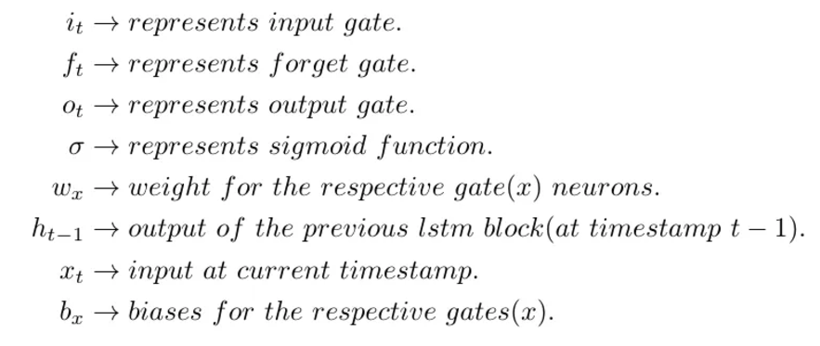
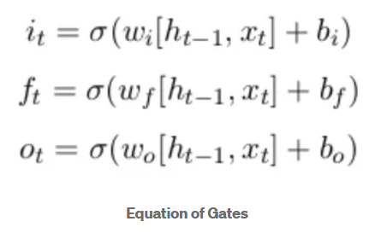
Mathematical Foundations
LSTM is made up of three gates:
Input gate: Determines which information to store in the memory cell
Forget gate: Determines which information to discard from the memory cell
Output gate: Determines which information to use for the LSTM's output

Slide 9
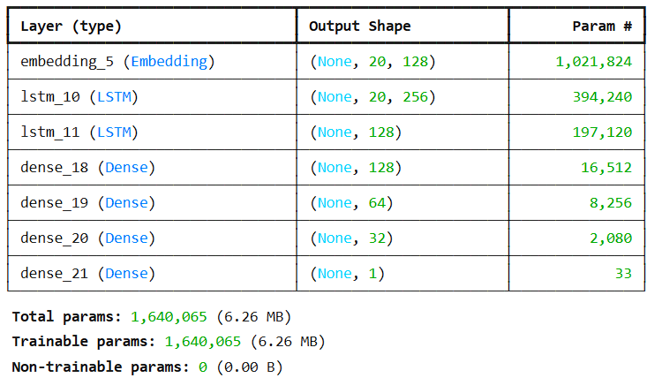
Model with 70% Train size and 30% Test size
Model Accuracy : 0.97
Model precision : 0.92
Model recall : 0.89
Model f1_score : 0.9
Classification Report :-
precision recall f1-score support
0 0.98 0.99 0.99 899
1 0.92 0.89 0.90 134
accuracy 0.97 1033
macro avg 0.95 0.94 0.94 1033
weighted avg 0.97 0.97 0.97 1033

Slide 10
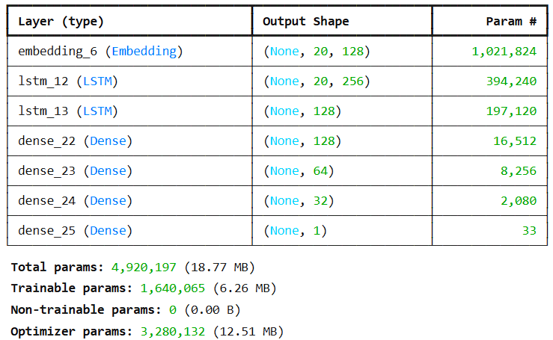
Model with 80% Train size and 20% Test size
Model Accuracy : 0.97
Model precision : 0.91
Model recall : 0.88
Model f1_score : 0.9
Classification Report :-
precision recall f1-score support
0 0.98 0.99 0.99 899
1 0.91 0.88 0.90 134
accuracy 0.97 1033
macro avg 0.95 0.93 0.94 1033
weighted avg 0.97 0.97 0.97 1033

Slide 11
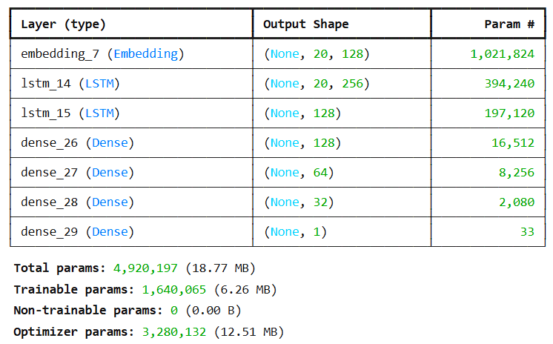
Model With Early Stopping with 20% Test size
Model Accuracy : 0.98
Model precision : 0.93
Model recall : 0.91
Model f1_score : 0.92
Classification Report :-
precision recall f1-score support
0 0.99 0.99 0.99 899
1 0.93 0.91 0.92 134
accuracy 0.98 1033
macro avg 0.96 0.95 0.95 1033
weighted avg 0.98 0.98 0.98 103

Slide 12
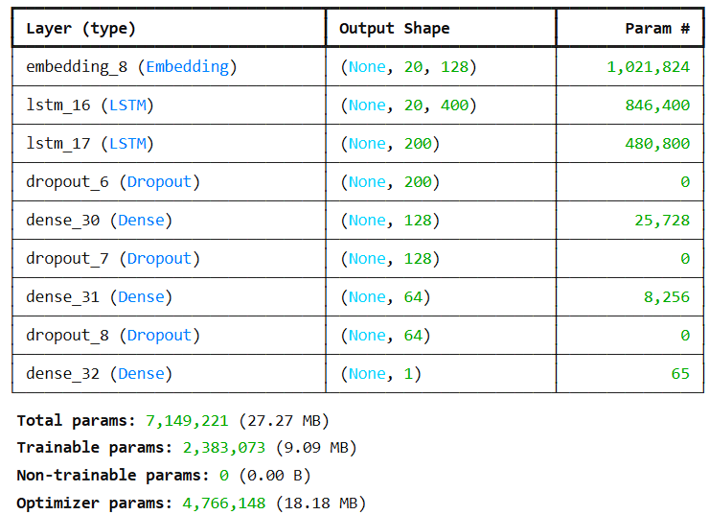
Model With Drop Out Layer with 20% Test size
Model Accuracy : 0.9
Model precision : 0.58
Model recall : 0.77
Model f1_score : 0.66
Classification Report :-
precision recall f1-score support
0 0.96 0.92 0.94 899
1 0.58 0.77 0.66 134
accuracy 0.90 1033
macro avg 0.77 0.84 0.80 1033
weighted avg 0.91 0.90 0.90 1033

Slide 13
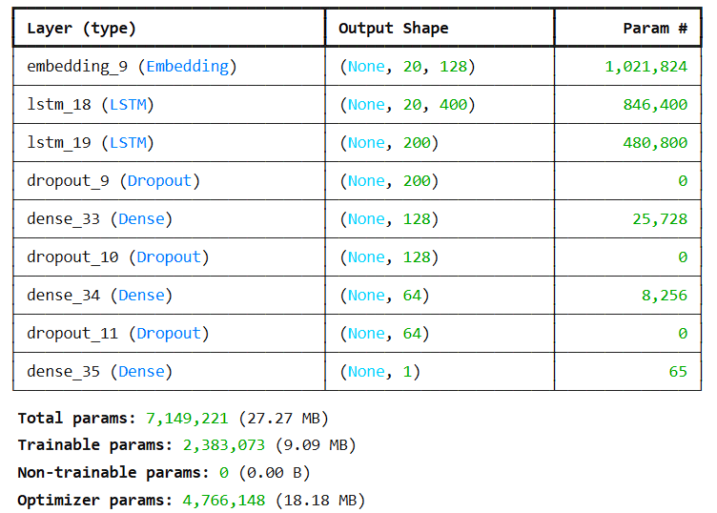
Model With Drop Out Layer & Early Stopping with 20% Test size
Model Accuracy : 0.97
Model precision : 0.91
Model recall : 0.9
Model f1_score : 0.9
Classification Report :-
precision recall f1-score support
0 0.98 0.99 0.99 899
1 0.91 0.90 0.90 134
accuracy 0.97 1033
macro avg 0.95 0.94 0.94 1033
weighted avg 0.97 0.97 0.97 1033

Slide 14
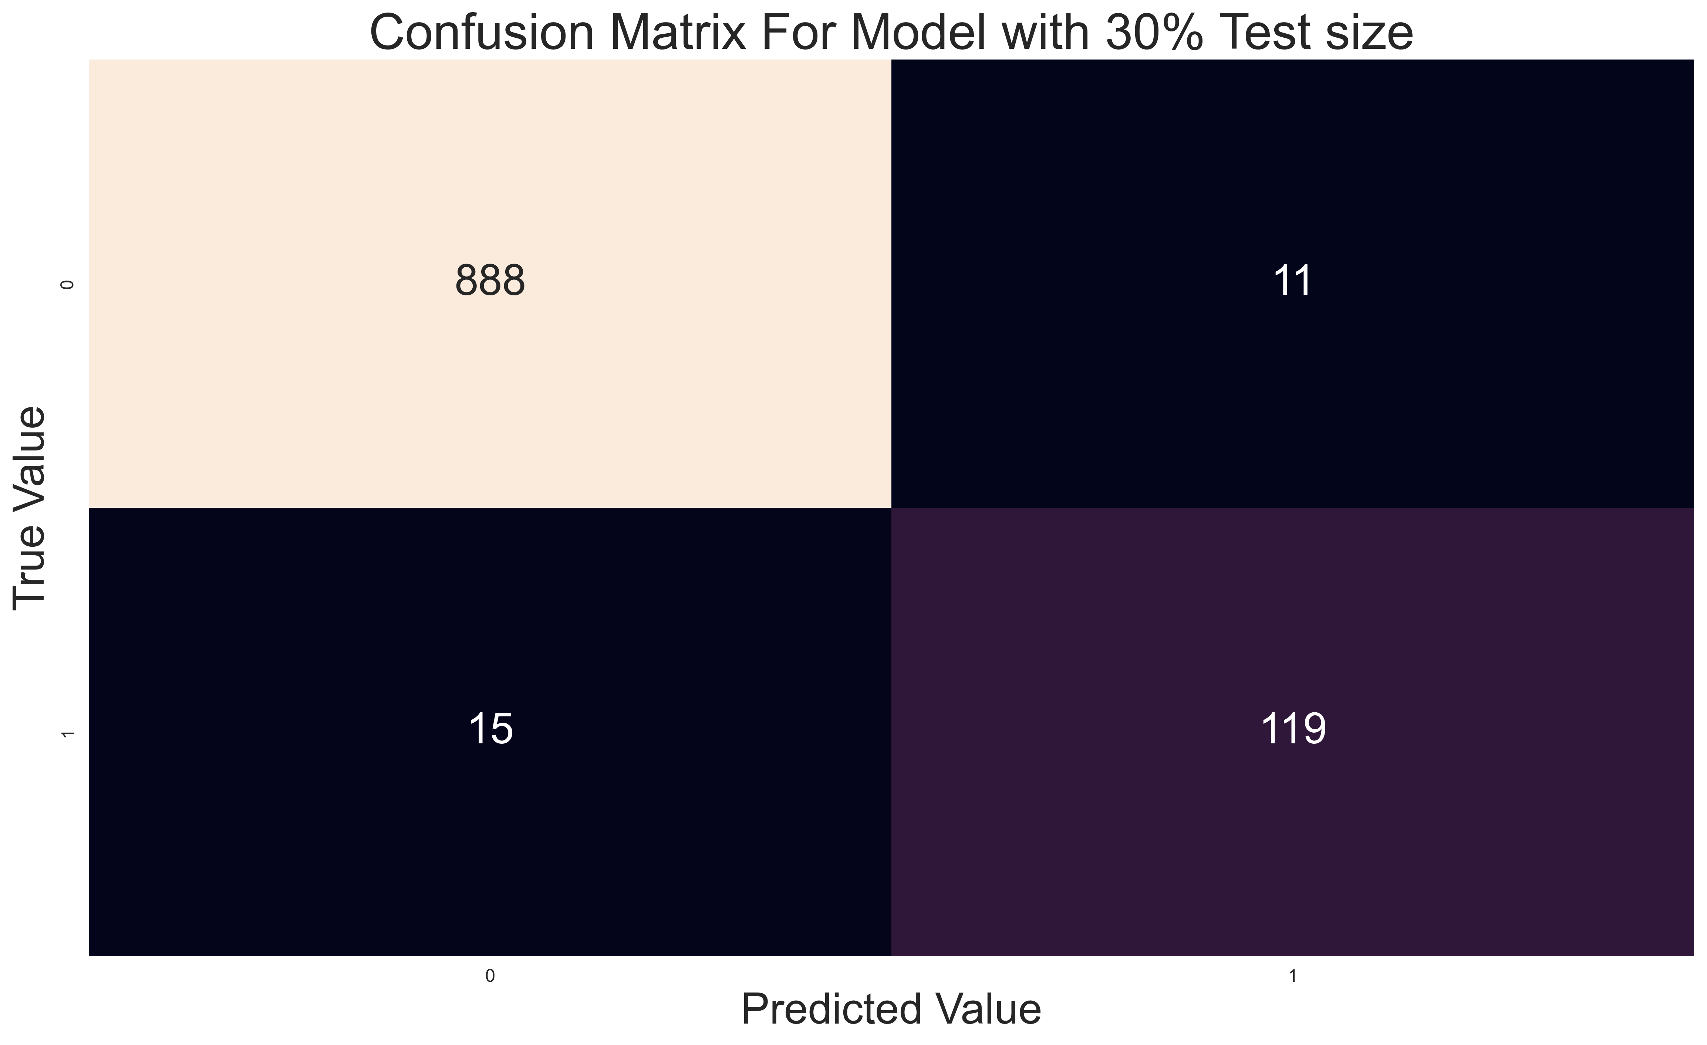
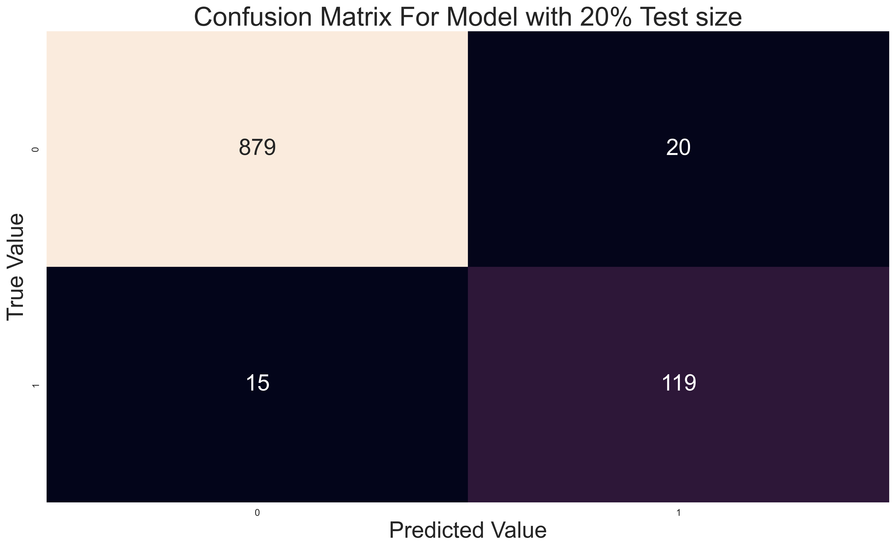
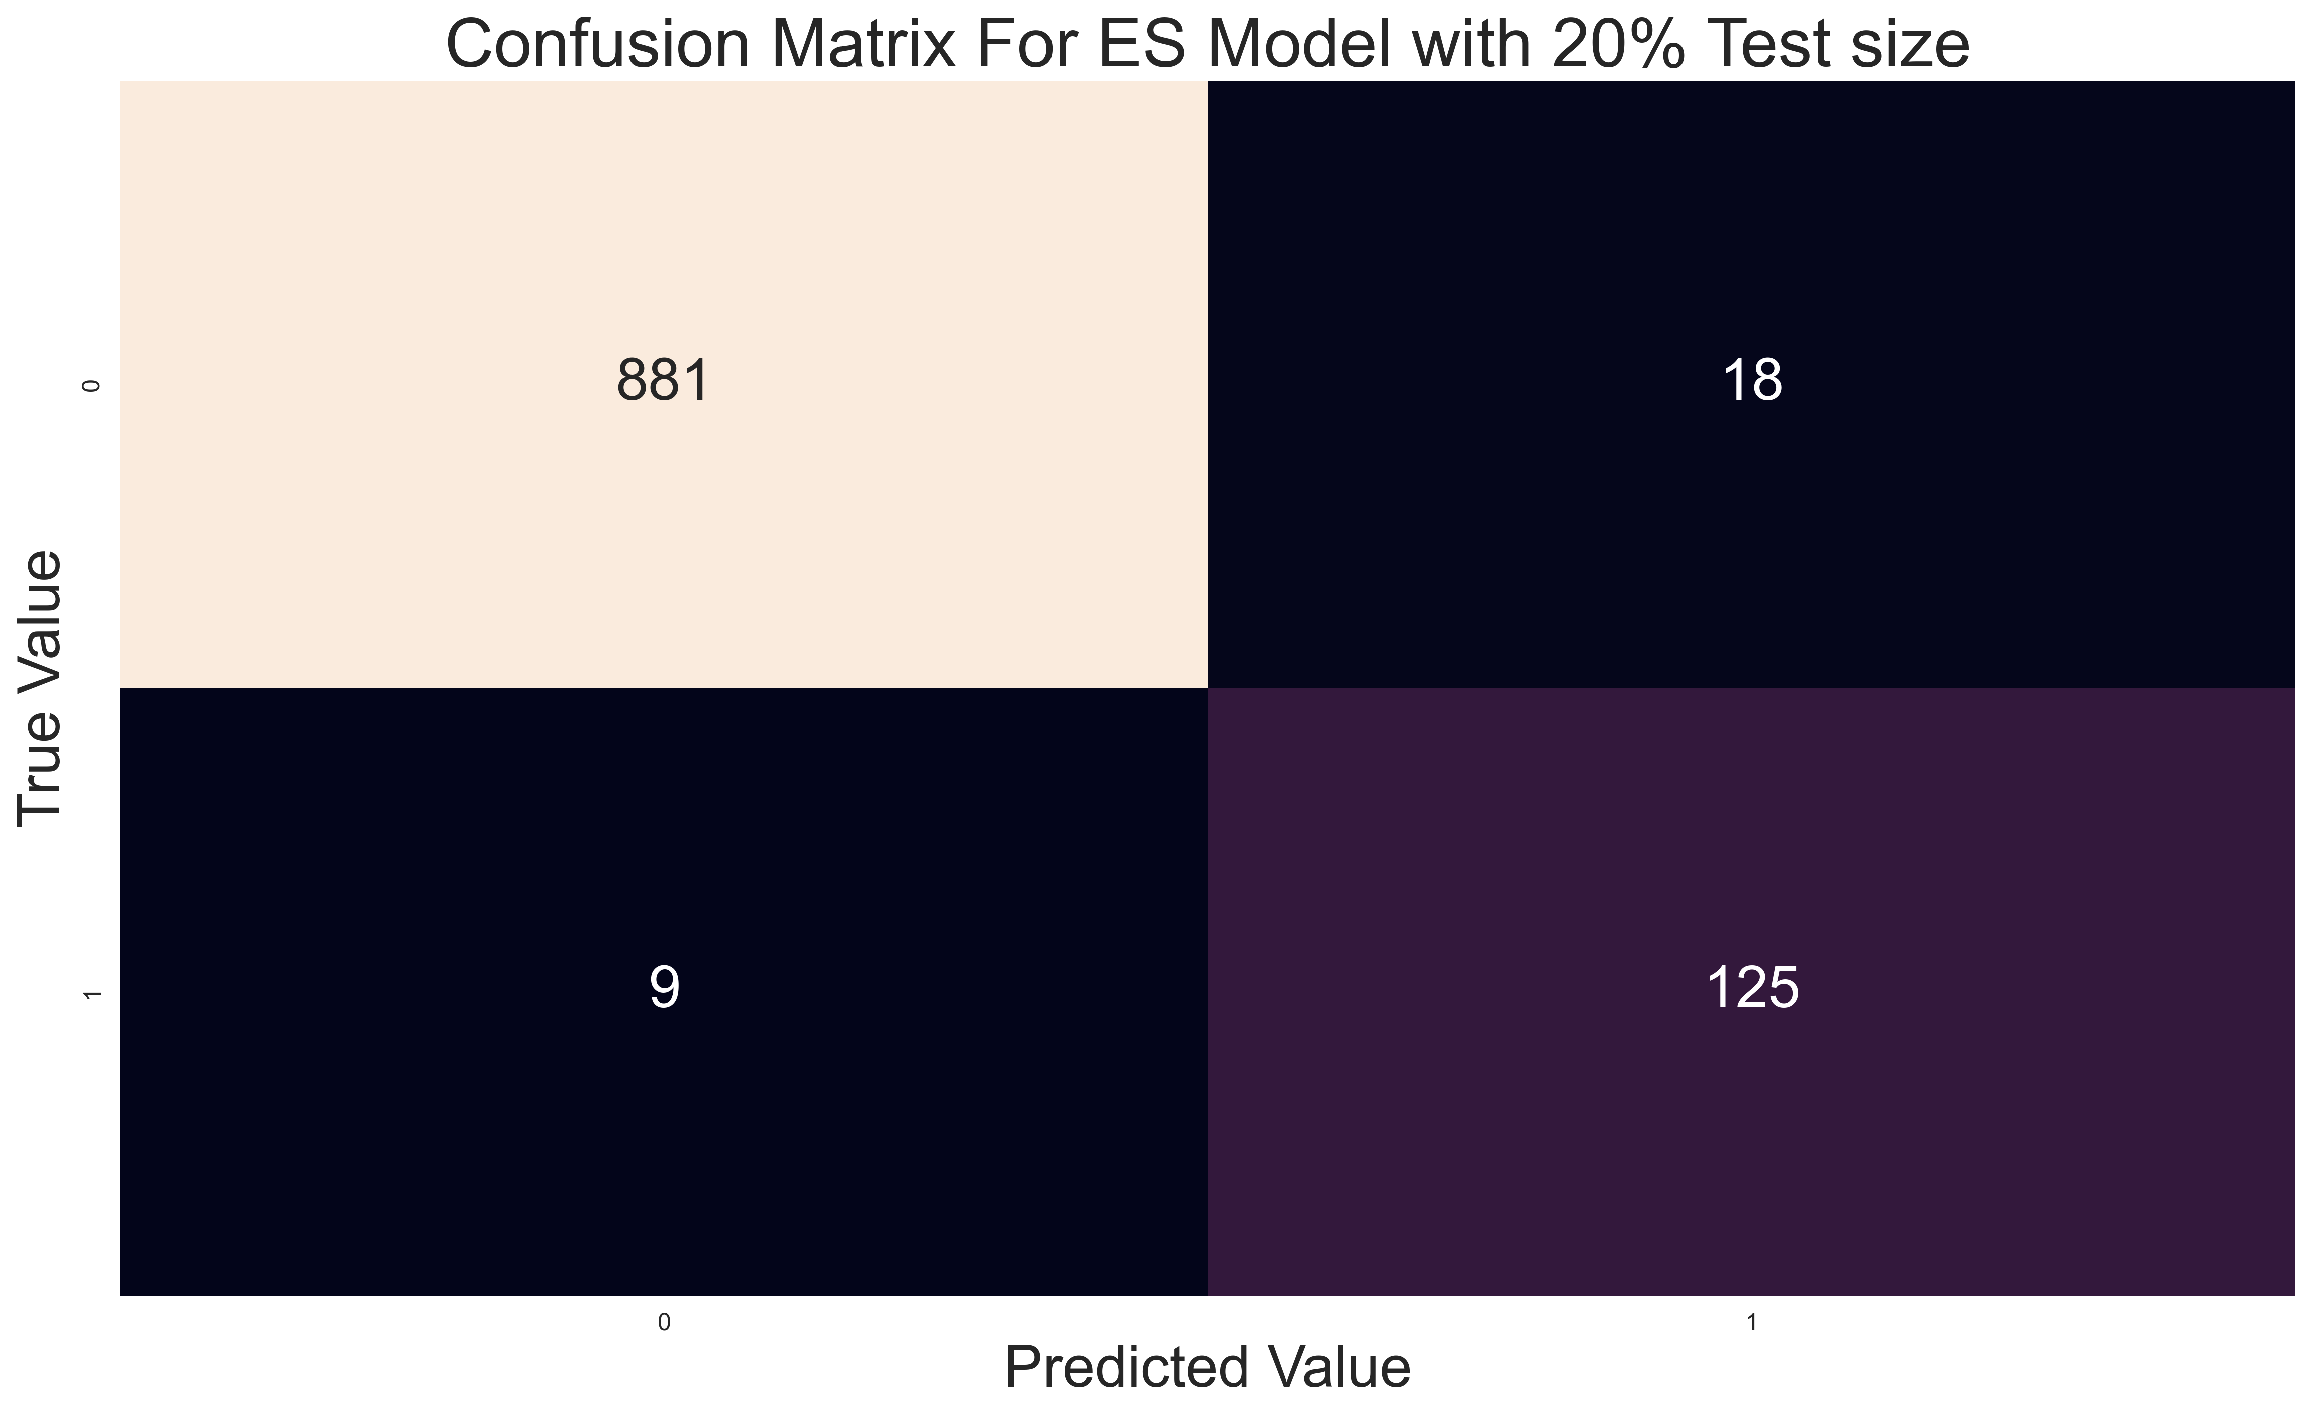

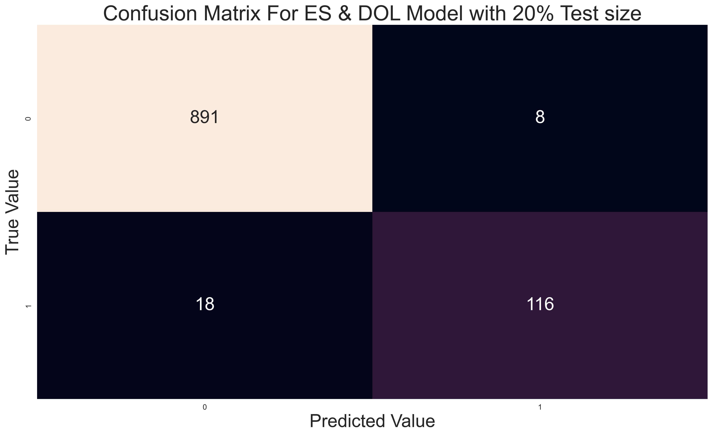
Confusion Martices for All Modes

Slide 15
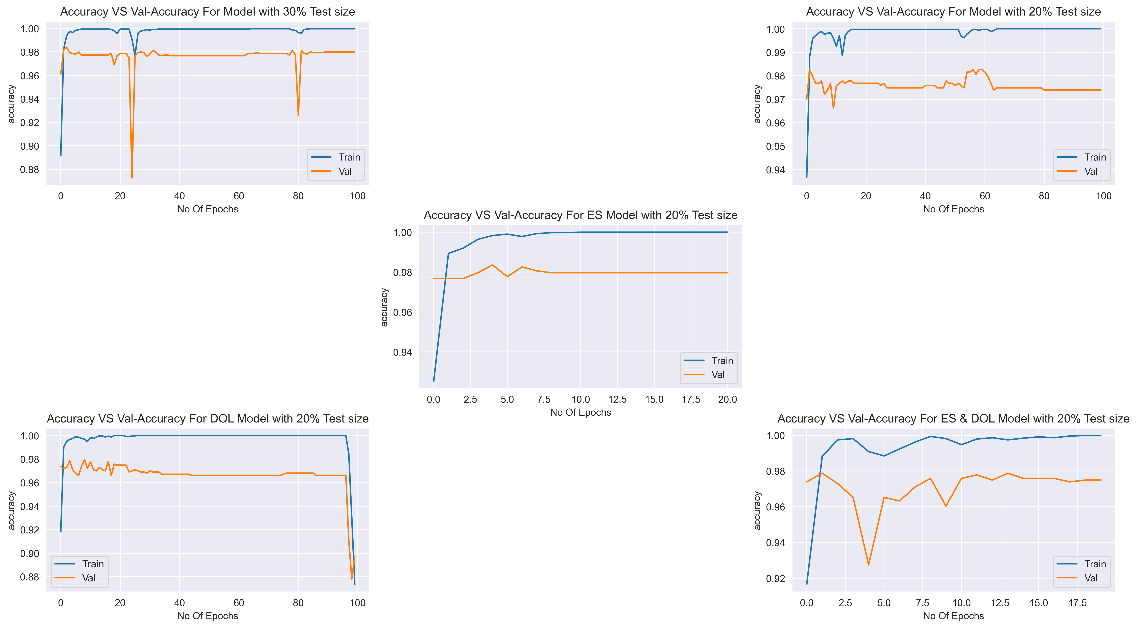
Ploting Accuracy vs Val-Accuracy For All Modes

Slide 16
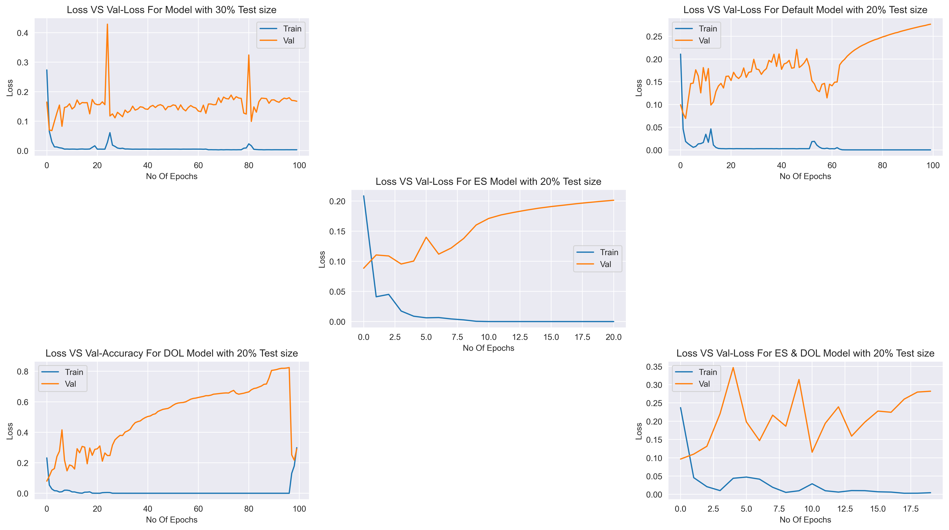
Ploting Loss vs Val-Loss For All Mode

Slide 17
Conclusion
Key Takeaways:
Successfully implemented a Long Short-Term Memory (LSTM) model for spam classification.
LSTM's ability to retain long-term dependencies in text data proved effective for distinguishing spam from non-spam messages.
Results:
Performance metrics such as precision, recall, and F1-score indicated robust detection of spam messages.
The model effectively reduced false positives and false negatives.

Slide 18
Repository Link:
https://github.com/sohamadhikari2000/Sms-Spam-Detector.git
Bibilography:
https://towardsdatascience.com/lstm-networks-a-detailed-explanation-8fae6aefc7f9
https://towardsdatascience.com/lstm-by-example-using-tensorflow-feb0c1968537
https://medium.com/@divyanshu132/lstm-and-its-equations-5ee9246d04af

Slide 19
Thank you

